Slide 1
DIABETICS ANALYSIS
BY ; ANURIYA RAVEENDRAN
BATCH : DA-DS
REINFORCEMENT 3 : TABLEAU DATA VISUALIZATION

Slide 2
INTRODUCTION
This dataset, analyzed in Tableau, explores the relationship between diabetes and various health factors such as BMI, HbA1c levels, blood glucose levels, smoking history, hypertension, and heart disease.
Using interactive visualizations, we uncover key insights, including the impact of age, lifestyle, and medical history on diabetes prevalence.
The dashboard includes bar charts, heatmaps, and trend lines, providing a clear understanding of risk factors and patterns in the dataset

Slide 3
AIM
The aim of this analysis in Tableau is to explore the relationship between diabetes and key health factors such as BMI, blood glucose levels, HbA1c levels, smoking history, hypertension, and heart disease.
By visualizing trends and patterns, we aim to identify potential risk factors and provide insights that can help in early detection and prevention of diabetes.

Slide 4
DATASET OVERVIEW
year | gender | age | location | race:AfricanAmerican | race:Asian | race:Caucasian | race:Hispanic | race:Other | hypertension | heart_disease | smoking_history | bmi | hbA1c_level | blood_glucose_level | diabetes | clinical_notes
2020 | Female | 32 | Alabama | 0 | 0 | 0 | 0 | 1 | 0 | 0 | never | 27.32 | 5 | 100 | 0 | Overweight, advised dietary and exercise modifications.
2015 | Female | 29 | Alabama | 0 | 1 | 0 | 0 | 0 | 0 | 0 | never | 19.95 | 5 | 90 | 0 | Healthy BMI range.
2015 | Male | 18 | Alabama | 0 | 0 | 0 | 0 | 1 | 0 | 0 | never | 23.76 | 4.8 | 160 | 0 | Young patient, generally lower risk but needs lifestyle assessment. Healthy BMI range. Elevated blood glucose levels, potential diabetes concern.
2015 | Male | 41 | Alabama | 0 | 0 | 1 | 0 | 0 | 0 | 0 | never | 27.32 | 4 | 159 | 0 | Overweight, advised dietary and exercise modifications. Elevated blood glucose levels, potential diabetes concern.
2016 | Female | 52 | Alabama | 1 | 0 | 0 | 0 | 0 | 0 | 0 | never | 23.75 | 6.5 | 90 | 0 | Healthy BMI range. High HbA1c level, indicative of diabetes or poor glucose control. Higher predisposition to hypertension and diabetes.
2016 | Male | 66 | Alabama | 0 | 0 | 1 | 0 | 0 | 0 | 0 | not current | 27.32 | 5.7 | 159 | 0 | Elderly patient with increased risk of chronic conditions. Overweight, advised dietary and exercise modifications. Elevated blood glucose levels, potential diabetes concern. History of smoking, potential lung and vascular health impact.

Slide 5
DATA UNDERSTANDING
year – Year of data entry.
gender – Gender of the patient.
age – Age in years.
location – State or region.
race – Various race categories (African American, Asian, Caucasian, Hispanic, Other).
hypertension – Whether the patient has hypertension (1 = Yes, 0 = No).
heart_disease – Whether the patient has heart disease (1 = Yes, 0 = No).
smoking_history – Smoking status (never, former, current, etc.).
bmi – Body Mass Index.
hbA1c_level – Average blood sugar level (HbA1c percentage).
blood_glucose_level – Blood glucose level in mg/dL.
diabetes – Presence of diabetes (1 = Yes, 0 = No).
clinical_notes – Text-based health notes

Slide 6
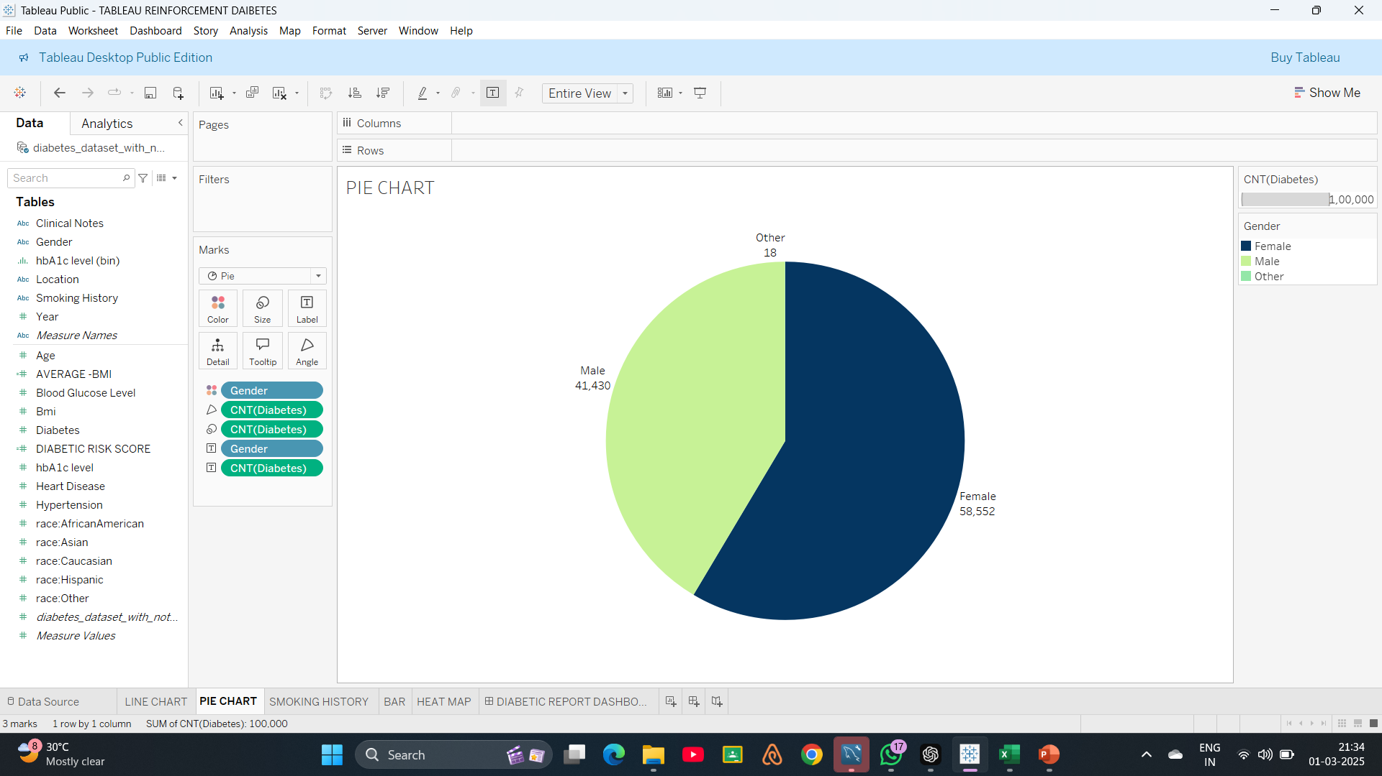
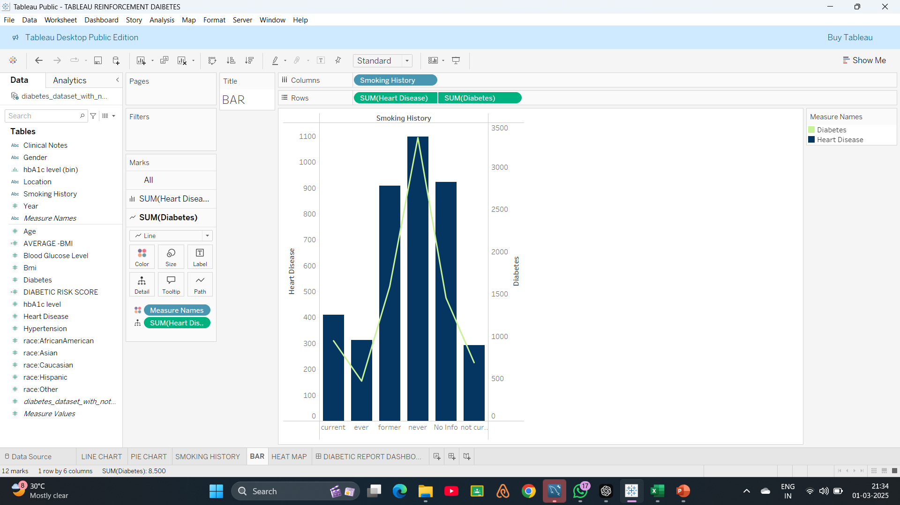
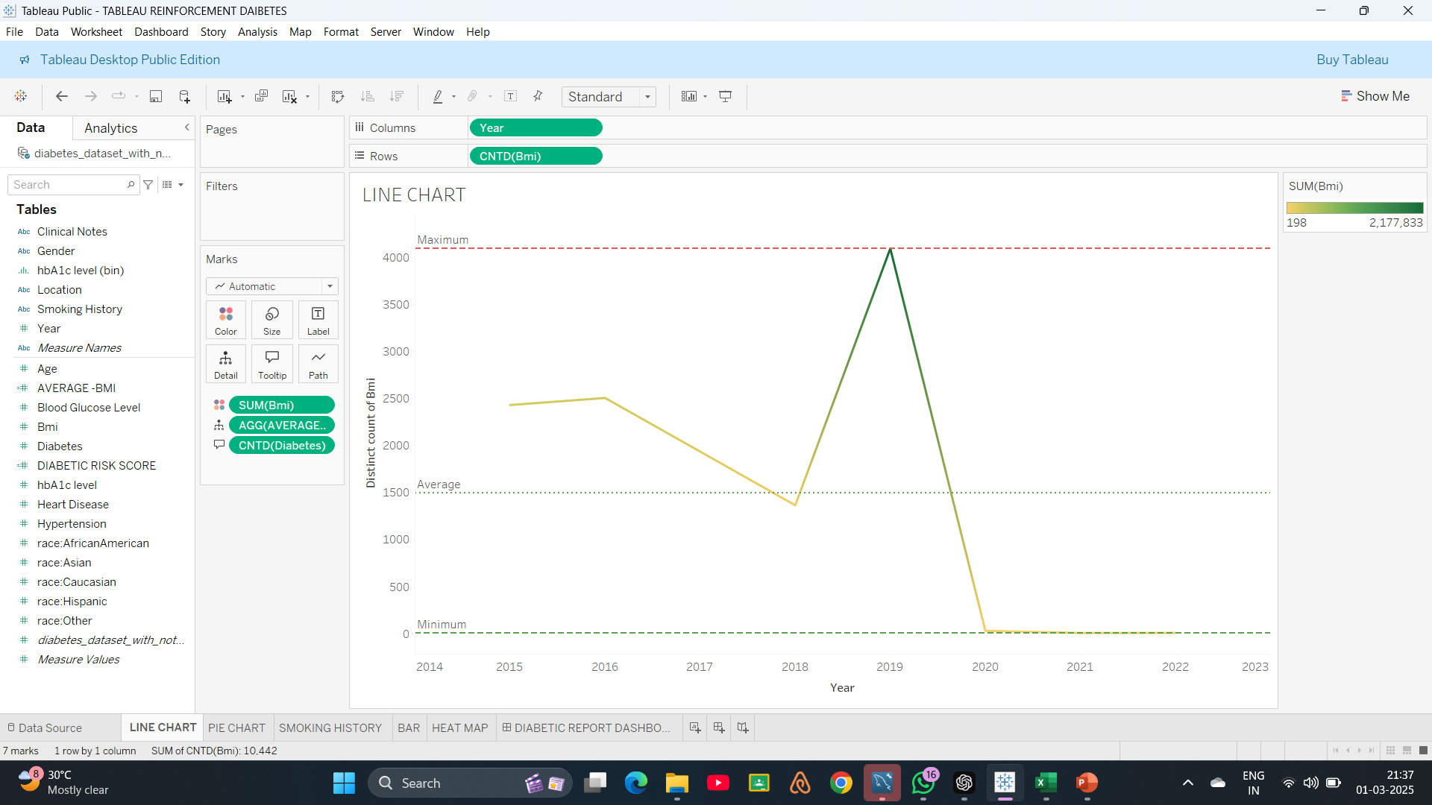
DATA VISUALIZATION

Slide 7
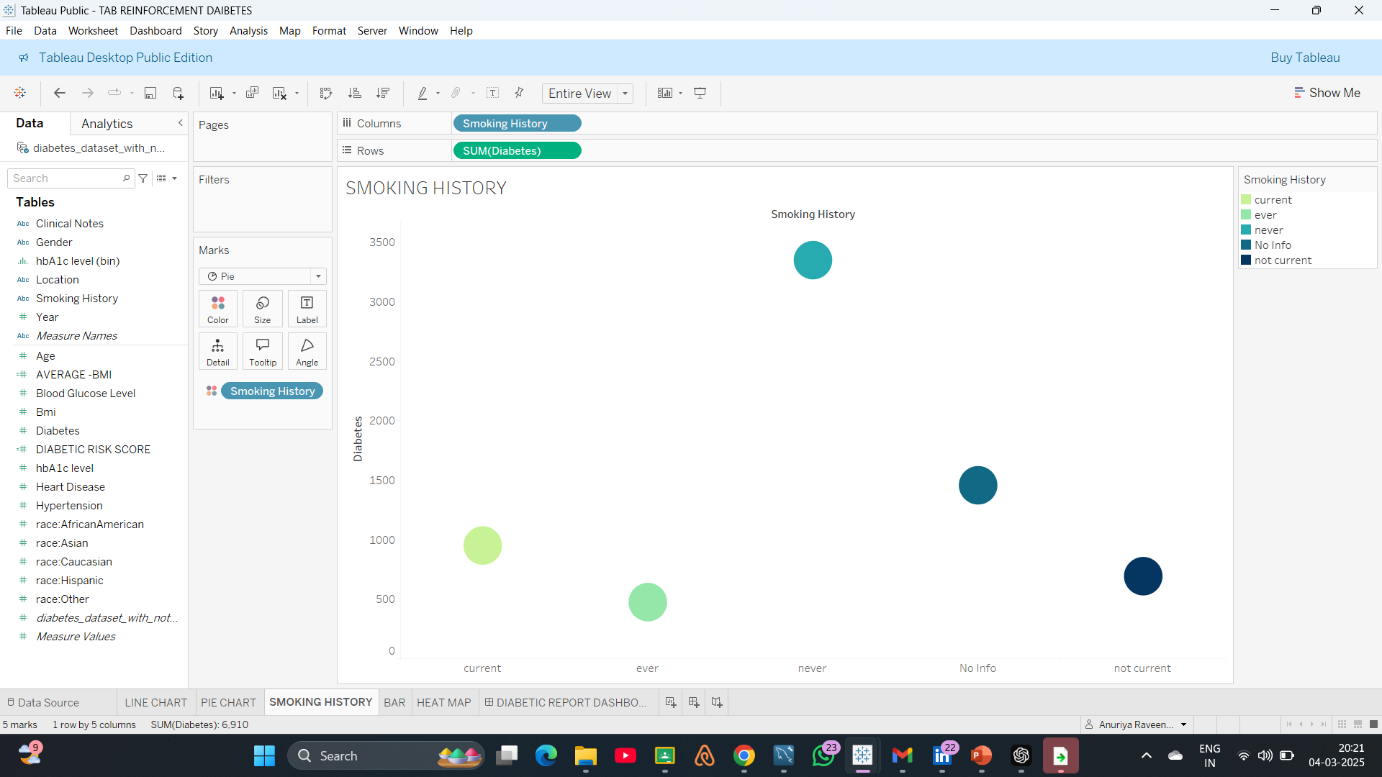
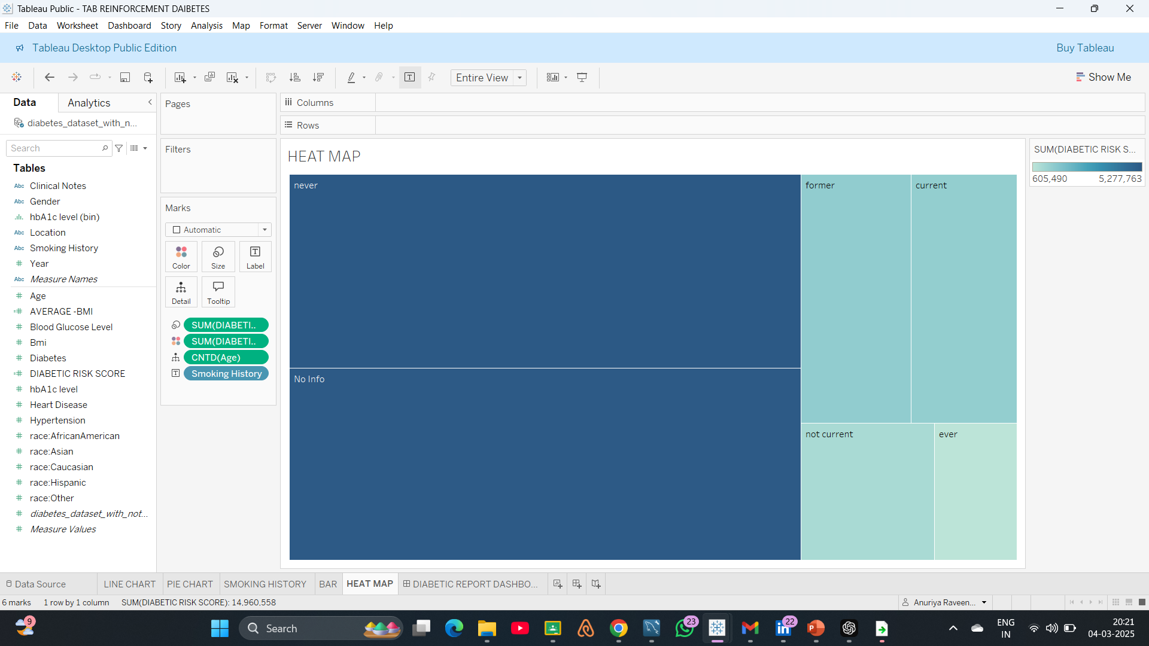

Slide 8
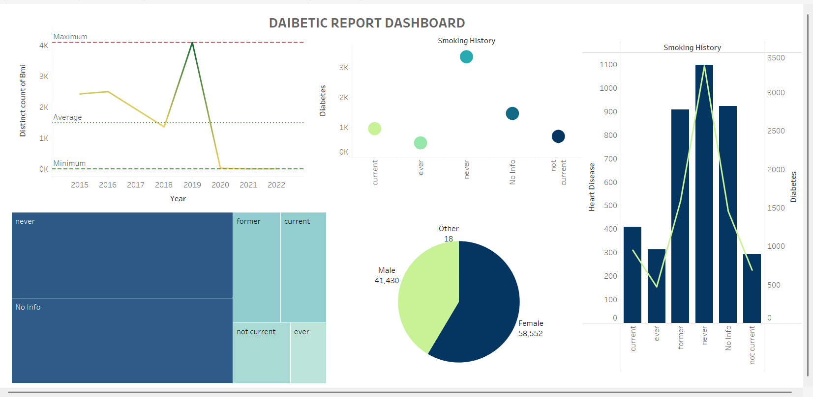
DASHBOARD OVERVIEW

Slide 9
CONCLUSION
BMI Trends Over the Years:
BMI counts peaked in 2019 and then dropped sharply in 2020.
This could be due to changes in data collection or a real-world event affecting BMI.
Smoking & Diabetes:
People who smoke (current or past) have higher diabetes cases.
Those who never smoked or have no smoking data show lower cases of diabetes.
Smoking & Heart Disease:
Surprisingly, non-smokers have the highest heart disease cases.
This means that other factors (like lifestyle or genetics) may play a bigger role.
Gender Distribution:
More females (58,552) than males (41,430) are included in the data.
A very small number of people fall under the "Other" gender category (18).

Slide 10
THANKYOU !

